Slide 1
Copyright and Teaching
Melanie T. Kowalski

Slide 2
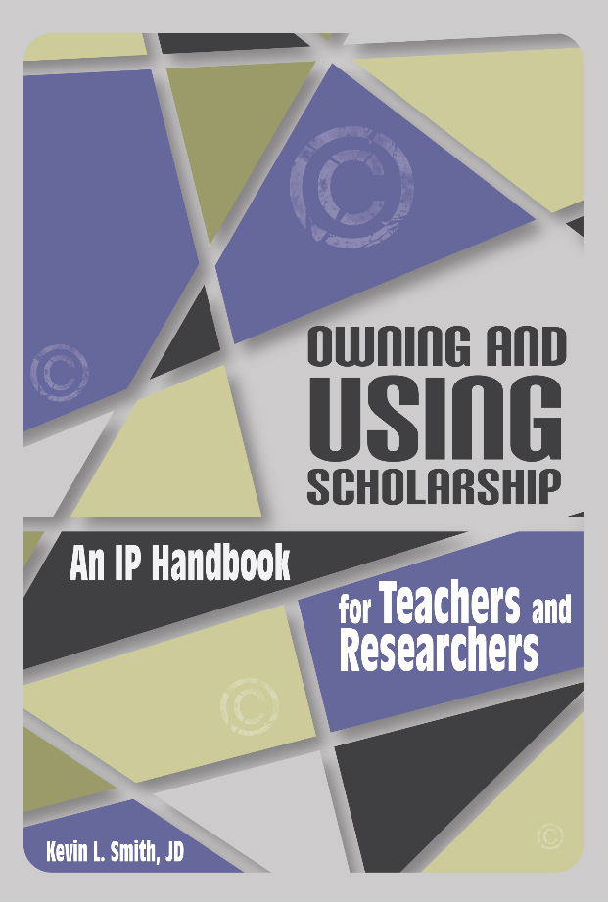
Copyright Overview – Questions?

Slide 3
Ultimate Question:
When should I worry about copyright?

Slide 4
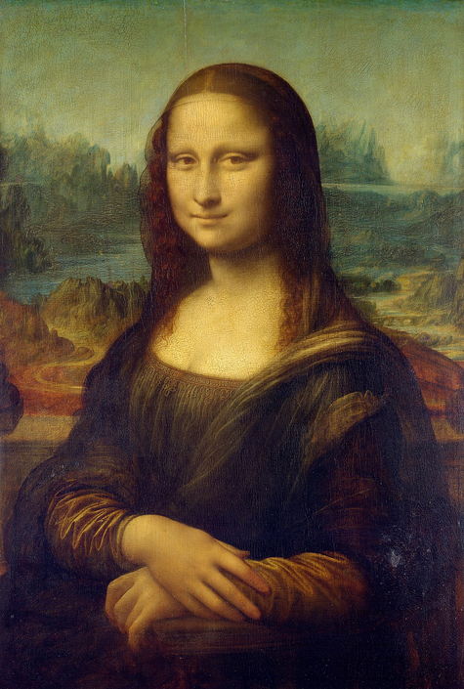
Teaching in the (physical) Classroom?
I am teaching a course on Leonardo da Vinci. I find a copy of the Mona Lisa online and paste it into my presentation slides.
Should I worry about ©?
Mona Lisa by Leonardo da Vinci retrieved from Wikipedia on 10/2/17.
Notes:
Classroom Exception: All performance and displays (including music, images, videos) of a work are not an infringement of copyright, as long as:
In the course of face-to-face teaching
It takes place in a classroom or similar place devoted to instruction
The work is lawfully obtained

Slide 5
Teaching in the (physical) Classroom?
Should I worry about ©?
NO
Notes:
Classroom Exception: All performance and displays (including music, images, videos) of a work are not an infringement of copyright, as long as:
In the course of face-to-face teaching
It takes place in a classroom or similar place devoted to instruction
The work is lawfully obtained

Slide 6
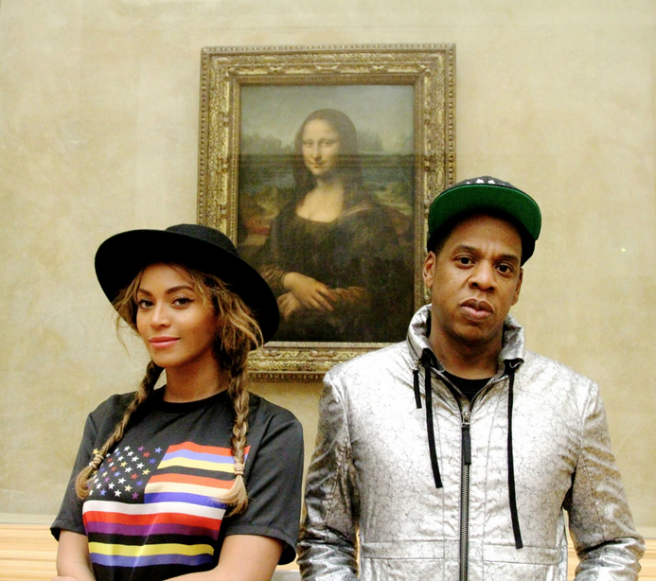
Teaching in the (virtual) Classroom?
I am teaching a course on popular culture, music, and female identity. I find a a picture of Jay-Z and Beyonce posing in front of the Mona Lisa and paste it into my presentation
slides. I post my slides on
our class Canvas site.
Should I worry about ©?
iam.beyonce.com retrived via Buzzfeed on 10/2/17
Notes:
The Classroom Teaching Exemption would not apply.
Fair use might apply depending on how you’ve integrated the picture into the slides – do you provide text in the slide or your notes that contextualizes the image? Or is it without the necessary context?

Slide 7
Teaching in the (physical) Classroom?
Should I worry about ©?
YES
Notes:
Classroom Exception: All performance and displays (including music, images, videos) of a work are not an infringement of copyright, as long as:
In the course of face-to-face teaching
It takes place in a classroom or similar place devoted to instruction
The work is lawfully obtained

Slide 8
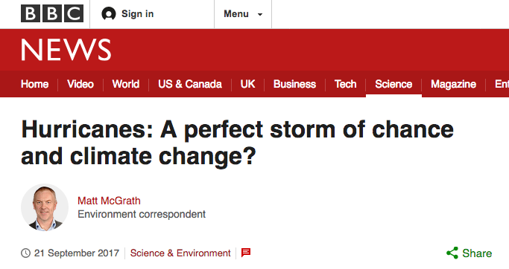
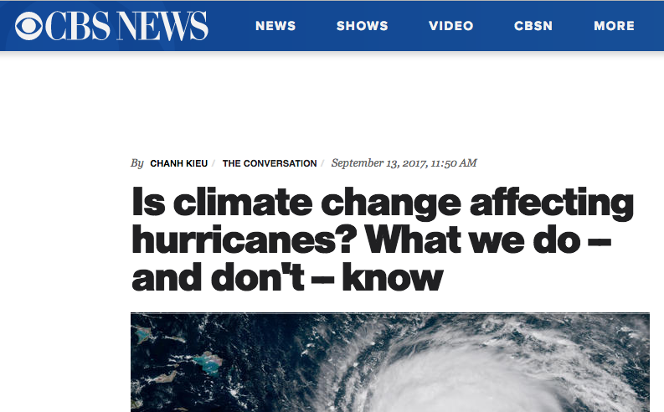
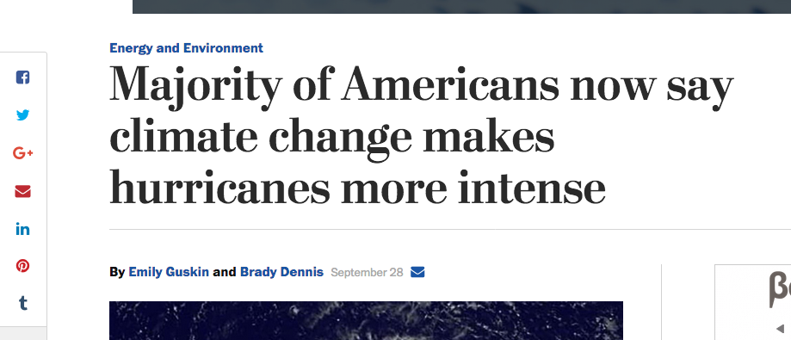
When Linking Online?
I am teaching a class on climate change. I find several articles online that I want to share with my students to help facilitate discussion. I put links to these articles in Canvas.
Should I worry about ©?
Notes:
Copyright law governs making a copy; linking to a website is not making a copy
Emory’s licenses for databases, eJournals and eBooks supersede copyright law, so always link since terms of licenses vary

Slide 9
When Linking Online?
Should I worry about ©?
NO
Notes:
Copyright law governs making a copy; linking to a website is not making a copy
Emory’s licenses for databases, eJournals and eBooks supersede copyright law, so always link since terms of licenses vary

Slide 10
When using items licensed through Creative Commons?
In my class on the history of public health outreach, I have decided to flip my classroom. I have made several lecture videos and posted them on Canvas for students to watch before class. All the images I included in the videos were licensed under the Creative Commons.
Should I worry about ©?
Notes:
Not if you use the work in accordance with the Creative Commons license
License conditions:
Attribution
Noncommercial
No Derivative Works
Share Alike

Slide 11
When using items licensed through Creative Commons?
Should I worry about ©?
MAYBE
(But probably not too much)
Notes:
Not if you use the work in accordance with the Creative Commons license
License conditions:
Attribution
Noncommercial
No Derivative Works
Share Alike

Slide 12
Assigning my students blogging/multimedia projects?
Next spring, I’ll be teaching a freshman composition course. Rather than writing the traditional persuasive argument essay, my students will be maintaining a blog. There they will post opinion pieces, podcasts, and photo essays on life as an Emory student.
Should I worry about ©?
Notes:
If students infringe on copyright, you as the instructor are not liable (unless you openly encourage them to completely circumvent the law….)
If students will be using copyrighted content, they need to know the basics of copyright law
You as the instructor should be able to provide your students with basic guidelines for ethical and legal best practices of using copyrighted content in an online environment.

Slide 13
Assigning my students blogging/multimedia projects?
Should I worry about ©?
MAYBE
Notes:
If students infringe on copyright, you as the instructor are not liable (unless you openly encourage them to completely circumvent the law….)
If students will be using copyrighted content, they need to know the basics of copyright law
You as the instructor should be able to provide your students with basic guidelines for ethical and legal best practices of using copyrighted content in an online environment.

Slide 14
Reusing Student Work?
This semester, my creative writing students will each produce a children’s story focused on courage and resilience. To demonstrate the impact of writing on a reader, my students will be going to a local elementary school to host a special story time session. They will share these stories with students in the 1st and 2nd grade. I would like to have all the stories bound into a special volume to gift to the elementary school’s library.
Should I worry about ©?
Notes:
Students own the copyright
Instructors need permission to…
Post online (even on Reserves or Blackboard)
Give copies to colleagues
Edit it
Publish it

Slide 15
Reusing Student Work?
Should I worry about ©?
YES
Notes:
Students own the copyright
Instructors need permission to…
Post online (even on Reserves or Blackboard)
Give copies to colleagues
Edit it
Publish it

Slide 16
Sharing readings with my students?
I have found several journal articles and book chapters on composition writing for business. I want to share these materials with my students during our 5th week of class, when we focus on business and technical writing. I go to the library and scan copies of the book chapters. I also download PDFs of journal articles. I post these on my class website, which is openly available.
Should I worry about ©?
Notes:
Reserves vs. Blackboard
All 3rd party copyrighted material should be put on Reserves, not Blackboard
Library will work through copyright clearance of Reserve items with you
Provost Permissions Fund
Don’t use Reserves to substitute for a textbook

Slide 17
Sharing readings with my students?
Should I worry about ©?
YES
Notes:
Reserves vs. Blackboard
All 3rd party copyrighted material should be put on Reserves, not Blackboard
Library will work through copyright clearance of Reserve items with you
Provost Permissions Fund
Don’t use Reserves to substitute for a textbook

Slide 18
Sharing readings with my students?
I have found several journal articles and book chapters on composition writing for business. I want to share these materials with my students during our 5th week of class, when we focus on business and technical writing. I go to the library and scan copies of the book chapters. I also download PDFs of journal articles. I upload copies of these to my classes Canvas site.
Should I worry about ©?
Notes:
Reserves vs. Blackboard
All 3rd party copyrighted material should be put on Reserves, not Blackboard
Library will work through copyright clearance of Reserve items with you
Provost Permissions Fund
Don’t use Reserves to substitute for a textbook

Slide 19
Sharing readings with my students?
Should I worry about ©?
YES
Notes:
Reserves vs. Blackboard
All 3rd party copyrighted material should be put on Reserves, not Blackboard
Library will work through copyright clearance of Reserve items with you
Provost Permissions Fund
Don’t use Reserves to substitute for a textbook

Slide 20
Still have questions?
Emory’s Scholarly Communications Office:
http://sco.library.emory.edu/
Owning and Using Scholarship: An IP Handbook for Teachers and Researchers by Kevin Smith
  Melanie T. Kowalski
  melanie.t.kowalski@emory.edu
  404-727-8286

